Slide 1
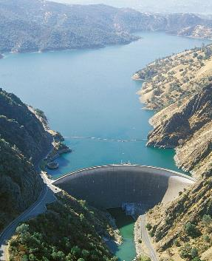
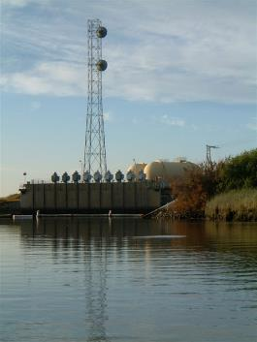
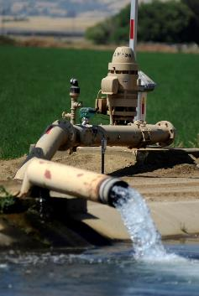
SOLANO WATER
Solano Project
NBA
Groundwater

Slide 2
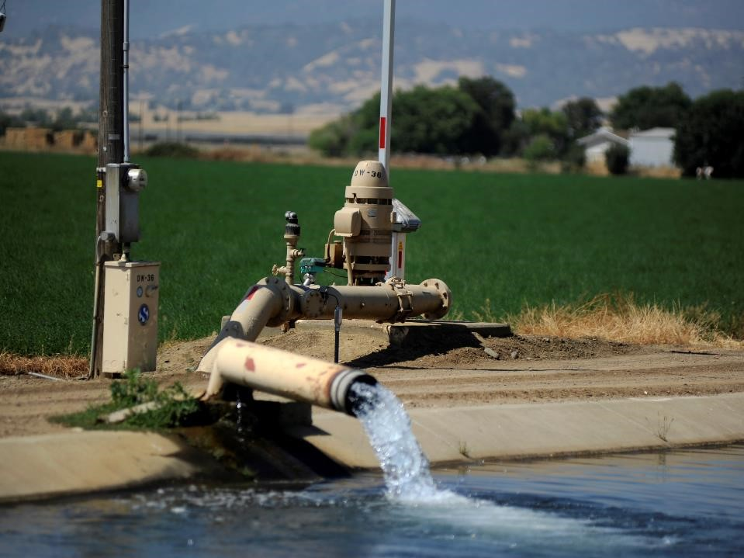
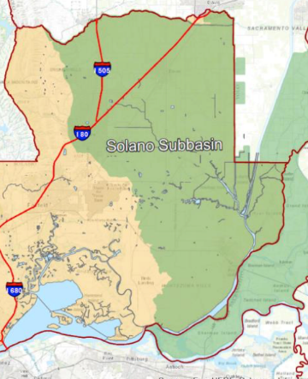




Groundwater
Groundwater Use
  Significant GW in eastern half of County
  Pre 1950s GW was overdrafted
  Post Solano Project, GW levels reversed and are stable
  Solano County has good GW resources
Sustainable Groundwater
Management Act (SGMA)
  2014, Legislation Passed
  2017, GSA (Governing Entity)
  2022, GSP (Long-term GW Plan)

Slide 3
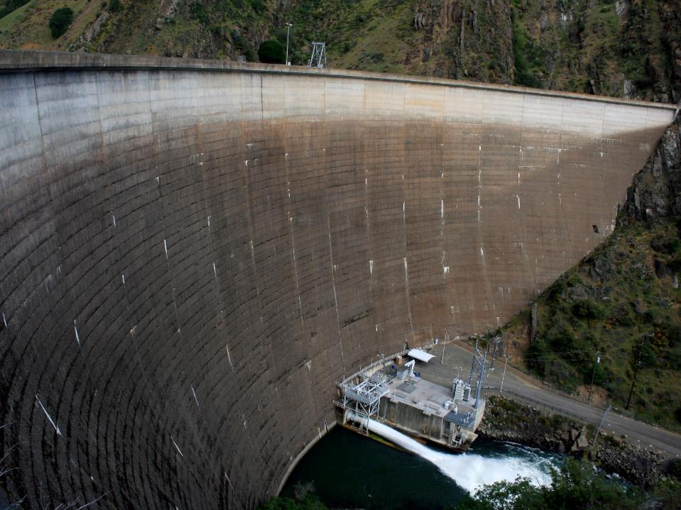



Solano Project
Water Supply (Municipal & Ag)
  400,000 residents
  75,000-ac, irrigation
Ownership
  Owned by USBR
  Federal loans paid off
  Managed/Operated by SCWA/SID
Other
  Local Water Rights
  Excellent Water Quality
  High Reliability

Slide 4

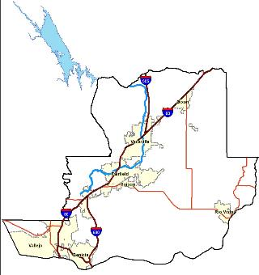
Solano Project
Lake Berryessa
STORAGE
- Volume: 1.6 million ac-ft
7th Largest Reservoir in CA

Slide 5
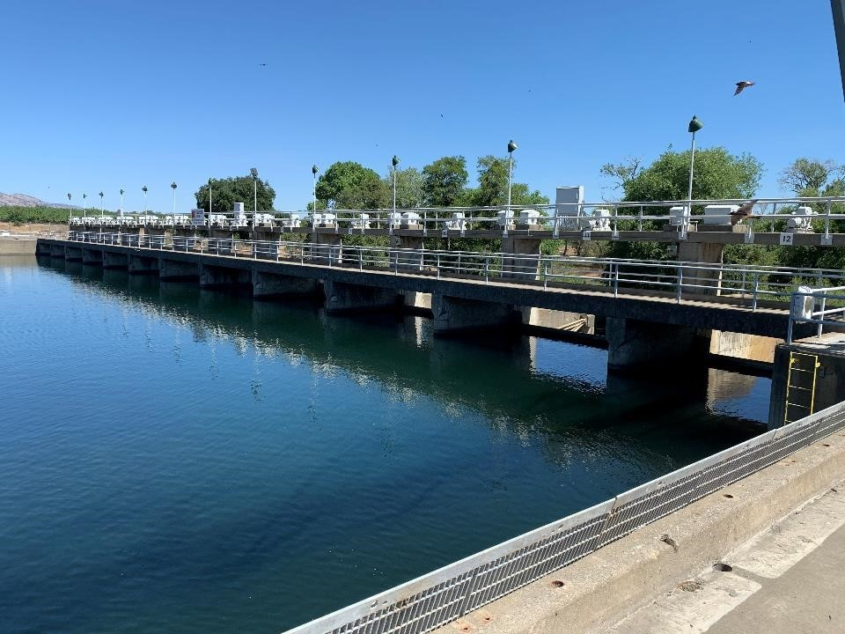
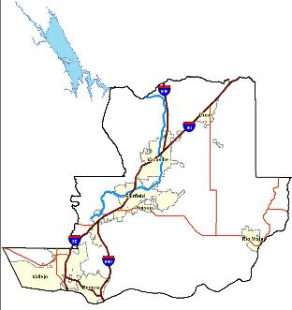
Solano Project
Lake Solano
DIVERSION
Diversion point to Putah Ck
& Putah South Canal

Slide 6
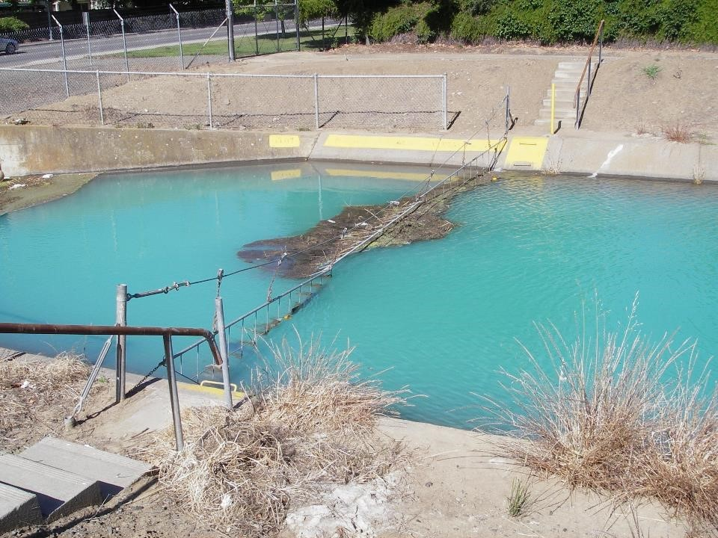
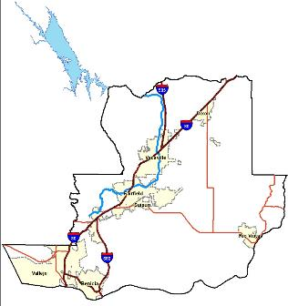
Solano Project
Putah South Canal
DISTRIBUTION
33 mile long canal
Lake Solano to Cordelia
Serves both Ag. and M&I

Slide 7
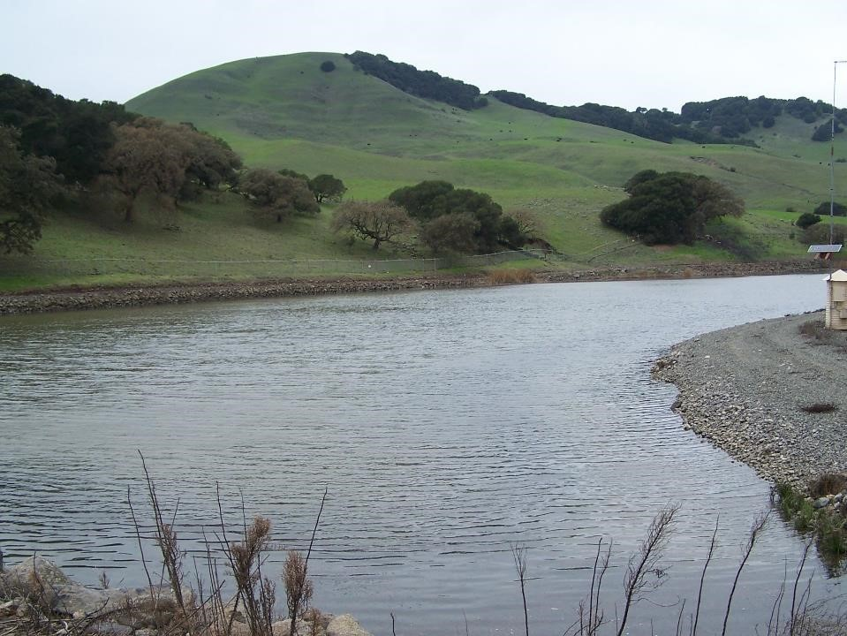
Solano Project
Terminal Reservoir
TERMINUS
9-acre reservoir
Terminus of project
Serves Vallejo & Benicia

Slide 8
Solano Project | Entitlements
Entitlements are Fixed.
Member agencies can:
  Purchase: $ for Water
  Exchange: Water A for Water B
  Call: $ for Water when Needed
Place of Use: 428,300 acres in Yolo & Solano Counties
Agency | Entitlement (AF)
Benicia | ---
Fairfield | 9,200
MPWD | 15,000
SID | 141,000
Suisun City | 1,600
Vacaville | 5,750
Vallejo | 14,600
CSP Solano | 1,019
UC Davis | 4,000
Losses | 15,000
Total | 207,169
Notes:
Average annual reliability 99%

Slide 9
Avg. Inflow = 300,000 AF
Inflow (2021) = 22,680 AF
Inflow (2017) = 1,007,600 AF

Slide 10
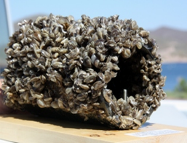
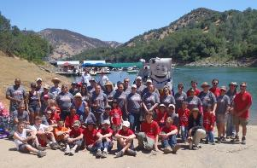
Solano Project (Summary)
Most important water supply for Solano County!
  Excellent water quality & reliability
Challenges
  Invasive Species | High Risk for Zebra/Quagga Mussels
  Management of Aquatic Plants & Sediment
  Aging Infrastructure (60-years old)
Notes:
Average annual reliability 99%

Slide 11
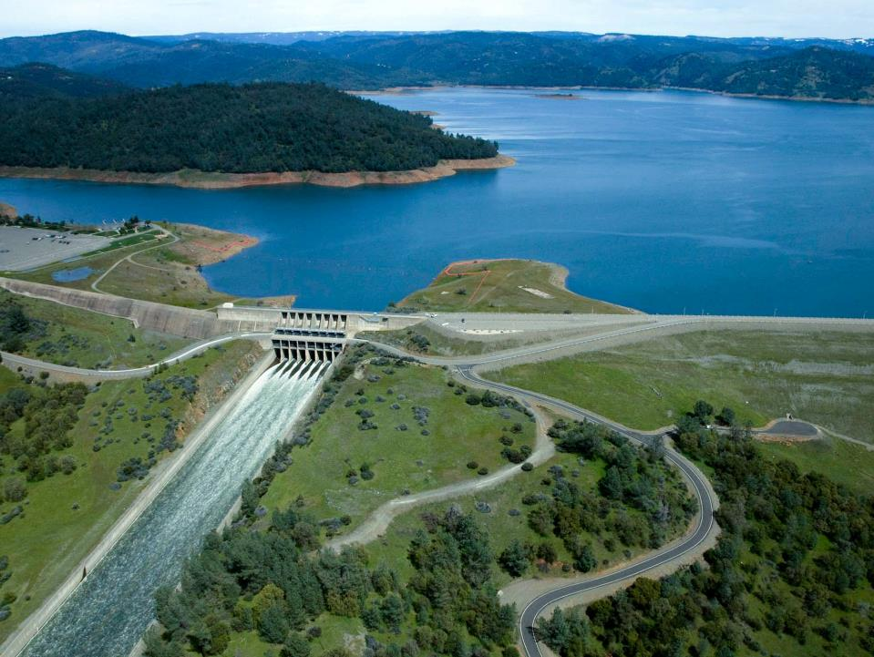
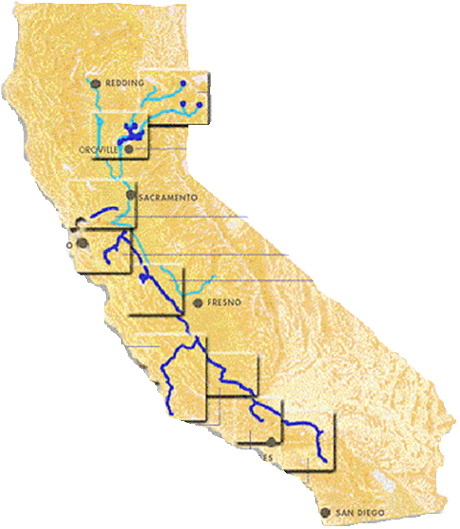

State Water Project (SWP)
Owned/Operated by DWR
SF Bay Area, San Joaquin & Tulare Basin, Central Coast, Los Angeles, San Diego
  27-Million | 70% of Californians
Facilities
  - 34 reservoirs,
  - 20 pumping plants,
  - 5 power plants,
  - 700-mi of canal/pipelines

Slide 12
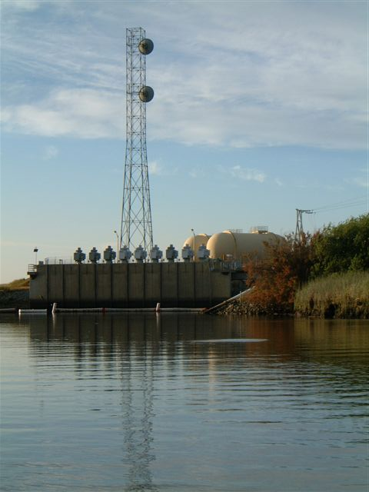
North Bay Aqueduct
Water Supply (Municipal)
  500,000 residents
  Napa, Am Canyon, Calistoga
  Benicia, Fairfield, Vacaville, Vallejo, Travis AFB
  (Suisun City, Dixon, Rio Vista)
  30 to 100% Municipal Water Supply
Ownership
  Owned by DWR
  Operated by DWR
Other
  Moderate Reliability
  Poorest WQ in SWP
  ESA Challenges (Delta & Longfin Smelt)
  In Cache Slough Complex (State Tidal Wetlands)

Slide 13
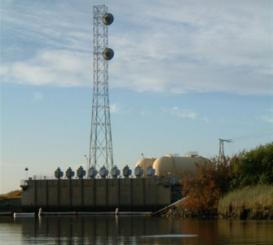
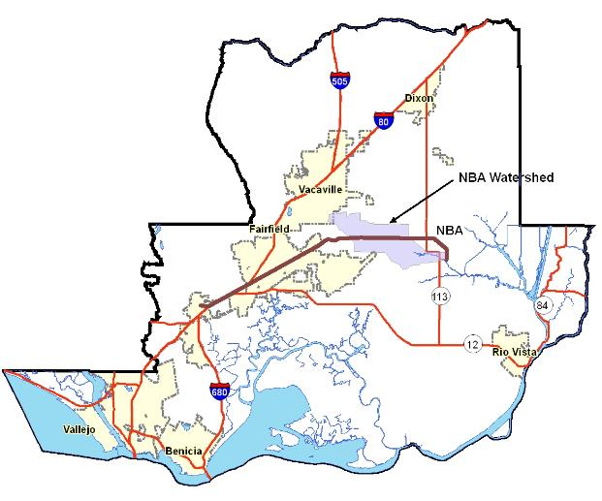
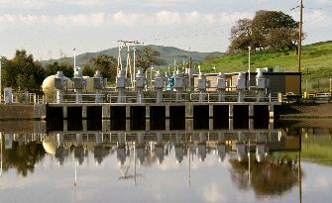
Napa County

Slide 14
NBA | Entitlements
Agency | Entitlement (AF)
Benicia | 17,200
Fairfield | 14,678
Suisun City | 1,300
Vacaville | 8,978
Vallejo | 5,600
Total | 47,756
Based on Allocation (Table A)
  SCWA Total = 47,756 AF
  Allocation Changes Annually
  Dixon & Rio Vista can opt-in
Water Types (Complex)
  Table A | Carryover | Settlement
  Transfers/Exchanges
  Advanced Table A | Article 21 | Yuba
Member agencies can
  Purchase
  Transfers/Exchange
  Very Specific Rules & Criteria
Place of Use
  SWP Service Area (much larger region)
All About the Details
Notes:
Rio Vista = 1,500-AF (5-year Notice)
Dixon = 1,500-AF (5-year Notice)
Reductions to Benicia, Fairfield, Vallejo

Slide 16
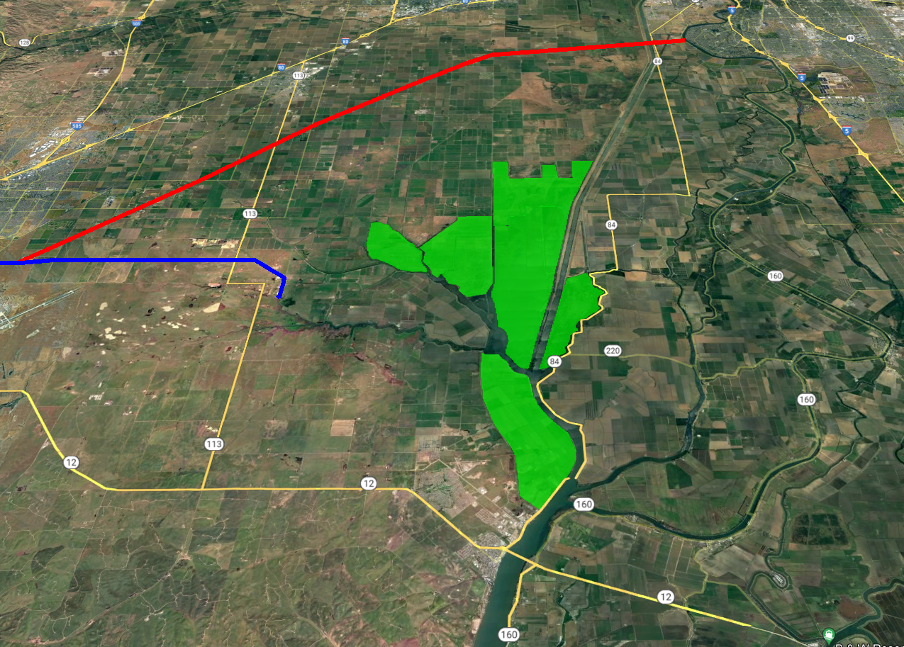
SACRAMENTO
DIXON
NBA Water Plus
VACAVILLE
Tidal Wetland Restoration
NBA
12-miles
(2-weeks)
RIO VISTA

Slide 17
NBA (Summary)
Important Municipal Water Supply
  Serves Napa & Solano Counties
  Provides 30 to 100% Municipal Water Supply
  Statewide Water Supply / Flexibility
Challenges
  Moderate Reliability
  Poor Water Quality
  ESA Challenges (Delta & Longfin Smelt)
  Region of Tidal Wetlands
NBA Water Plus: $600+ Million
  Very expensive project

Slide 18
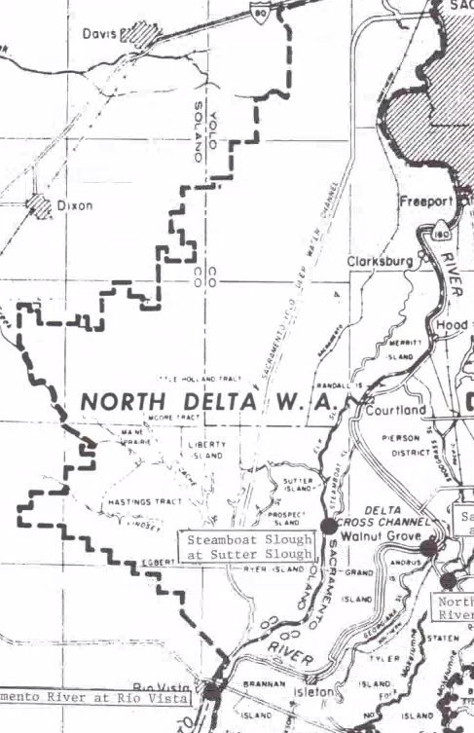
Other Water Supplies
Regional Supplies not under SCWA’s purview
Vallejo Permit Water
  Water Right for the City of Vallejo
  31.5-cfs (22,825-AF per year)
  Parallel Pipe to the NBA
  More Senior then the SWP/NBA
  Can be used in Am Canyon, Vallejo, Fairfield, Benicia
North Delta Water Agency (NDWA) Water
  Water Agreement/Assurance with DWR
  Municipal, Agricultural, Industrial Water
  Maine Prairie Water District (2/3 of District)
  Reclamation District 2068
  Hastings Tract, Ryer Island, Peterson Estates (Flannery)
  Must remain with the NDWA boundaries

